Slide 1
DEEP LEARNING MISCELLANEOUS
Bakul Gohel, Ph.D.
DA-IICT, Gandhinagar

Slide 2
Machine Learning / Deep Learning
Predictive Perspective
Classification
Regression
Descriptive Perspective
Describe classification situations in data
Difference between two group ; significance
clustering
Univariate -> multivariate ; significance !

Slide 3
Performance Measures

Slide 4
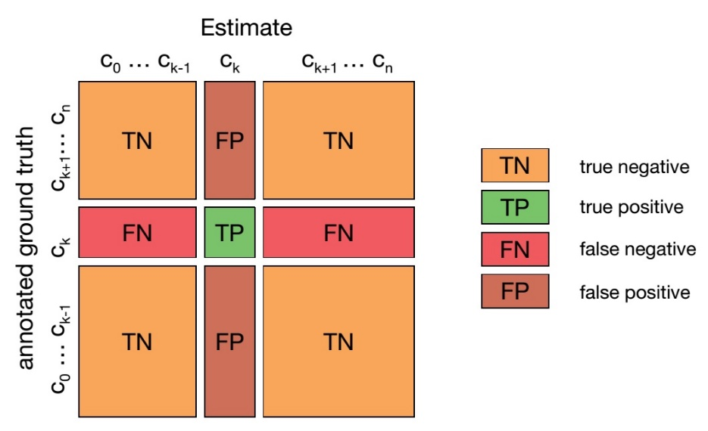
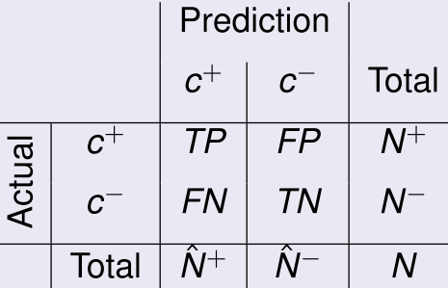
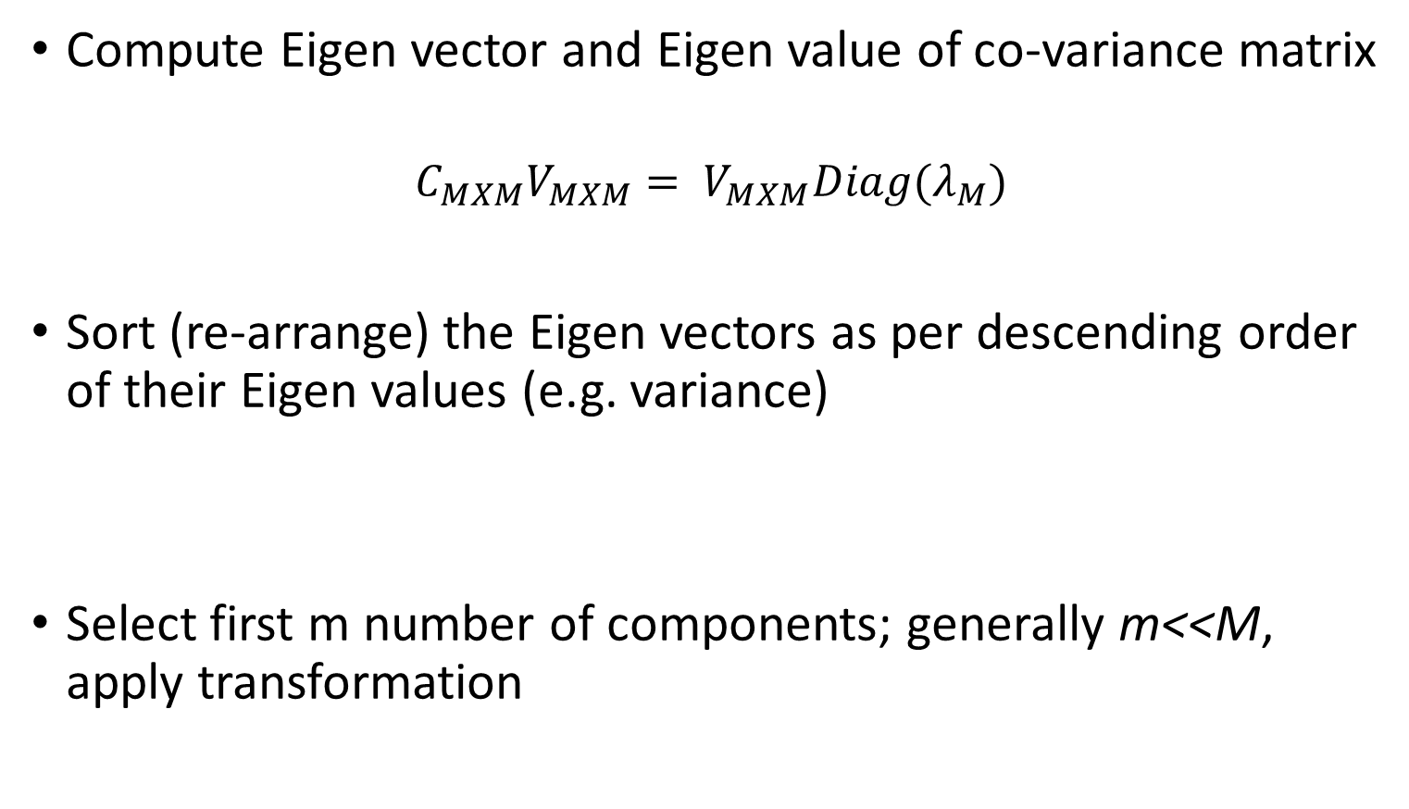
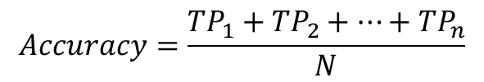
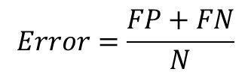
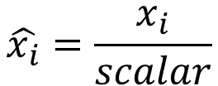
Confusion Matrix / classification
TP: True Positive
FP: False Positive
TN: Ture Negative
FP: False Positive
TWO CLASS
$$Accuracy=\frac{TP+TN}{N}$$
$$Accuracy=\frac{{TP}_{1}+{TP}_{2}+…+{TP}_{n}}{N}$$
$$Error=\frac{FP+FN}{N}$$
$$Error=(1 −accuracy)$$

Slide 5
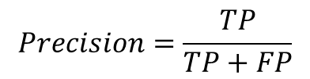
Performance / classification
Precision / Positive Predictive Value
Fraction of data sample classified as positive class which are actually positive
Video or music recommendation
Google page ranking
Spam email identification
$$Precision=\frac{TP}{TP+FP}$$

Slide 6
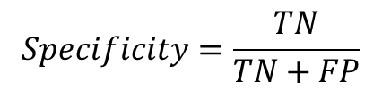

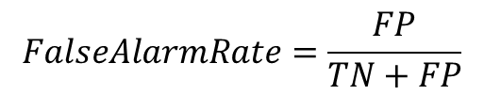
Performance / classification
Recall/True positive rate/Sensitivity
Fraction of positive class samples correctly classiﬁed
Clinical disease(class of interest) identification…
Specificity / 1-FalseAlarmRate
Fraction of negative class samples correctly identiﬁed
$$Recall=\frac{TP}{TP+FN}$$
$$Specificity=\frac{TN}{TN+FP}$$
$$FalseAlarmRate=\frac{FP}{TN+FP}$$

Slide 7
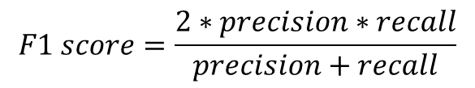
Performance / classification
F1-score: simpler metric which takes into account both precision and recall
$$F1 score=\frac{2∗precision∗recall}{precision+recall}$$

Slide 8
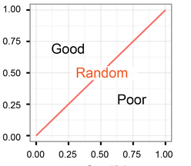
ROC or AUC / classification
Receiver operating characteristic
ROC curve is a plot of TPR against FPR which depicts relative trade-offs between benefits (true positives) and costs (false positives)
TruePositiveRate
Sensitivity
FalsePositiveRate
(1-Specificity)

Slide 9
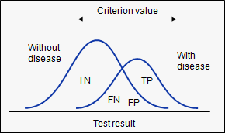
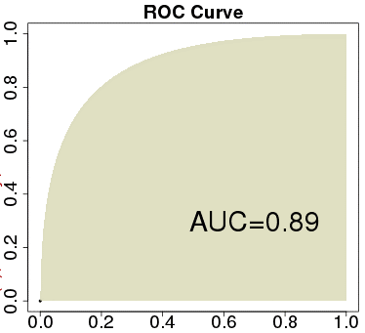
ROC or AUC / classification
Different points on the curve is computed from different threshold values
Higher the Area Under the Curve (AUC) better is the performance

Slide 10

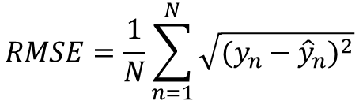
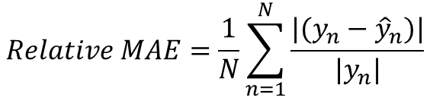
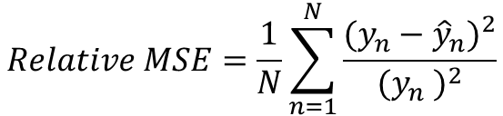
Performance / regression
RMSE or MSE
MAE
Relative MSE
Relative MAE
correlation
$$RMSE=\frac{1}{N}\sum_{n=1}^{N}{\sqrt{{(y_{n}−{\hat{y}}_{n})}^{2}}}$$
$$MAE=\frac{1}{N}\sum_{n=1}^{N}{|(y_{n}−{\hat{y}}_{n})|}$$
$$Relative MSE=\frac{1}{N}\sum_{n=1}^{N}{\frac{{(y_{n}−{\hat{y}}_{n})}^{2}}{{(y_{n} )}^{2}}}$$
$$Relative MAE=\frac{1}{N}\sum_{n=1}^{N}{\frac{|(y_{n}−{\hat{y}}_{n})|}{{|y}_{n}|}}$$

Slide 11
Data Representation

Slide 12
DATA TYPE
Numerical data
Height:=178cm , weights:=68kg etc.
Signals
Nominal data
Attendance:= Present / absent
Color:= Red / green / blue / yellow …
Ordinal
Income level:= low / medium / high / very high
Nominal/ordinal data -> Numerical data transformation
Many ML methods works only with real (input and output) values..

Slide 13
DATA PRE-PROCESSING
Missing and Inconsistent data
Data Normalization
Dimensionality reduction
Attribute(s) or Feature(s) selection
Attribute(s) or Feature(s) creations

Slide 14
MISSING DATA
Missing value
Age: ‘’, height=‘’
Bad data or noise
Age: ‘-10’, height=‘250cm’
outliers
Many algorithms can not handles missing attribute value
Need to be replaced
Solution
Data filling or substitution
Mean, mode, median, clustering etc…
Data(tuple/observation) omission
Check for data duplication

Slide 15
DATA NORMALIZATION
If the scale of different features are different, then their contribution in calculating the solution are different, that mean attribute with higher scale may drive the learning..
For example for cardiac risk evaluation; feature set consist of age, income, weight, BP etc.
So, income scale is very big, may drive impact adversely on learn model
minimizes overflow or underflow issues

Slide 16


DATA NORMALIZATION
Z-score
Min-Max normalization
Scaling
You may use your own normalization approach...
$$\hat{x_{i}}=\frac{x_{i}−μ}{σ}$$
$$\hat{x_{i}}=\frac{x_{i}−data min}{data max−data min}\left(new max−new min\right)+new min$$
$$\hat{x_{i}}=\frac{x_{i}}{scalar}$$

Slide 17
Ensemble-learning

Slide 18
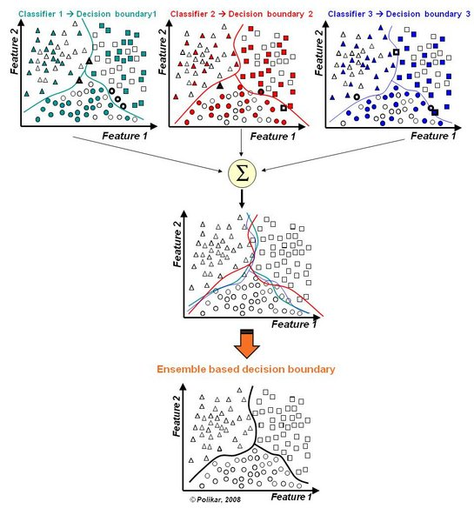
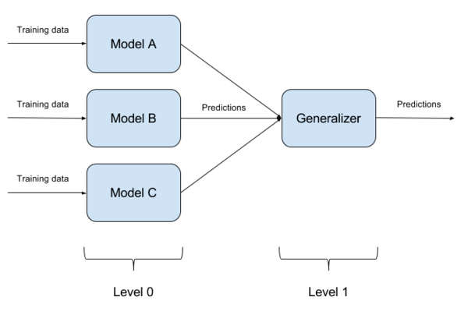
Ensemble-learning
For better Generalization
Models may be homogenous or heterogeneous

Slide 19
Ensemble Learning
Application
Better-generalization (regularization)
Data imbalance
Multi-class classification through binary classification
Generalization or Decision making
Voting based approach
Averaging or weighting
Your own application specific approach

Slide 20
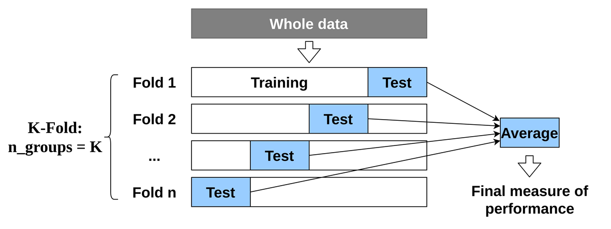
Cross-Validation
K-fold cross-validation;
if K=1 then leave one out cross validation
Does it reliable method compared to single split train-test approach ?
We have K models, which one is valid ? Or use as a ensemble of models (minimize overfitting)
For limited data availability !
May partly take care of class imbalance if proper partitioning the data is done
Hyper-parameter tuning….

Slide 21
Data Imbalance

Slide 22
Data Imbalance
Usually the under represented class is the class of interest from the application point of view
Standard classifier learning algorithm are usually biased toward the majority class…
Accuracy is no longer a proper measure
Need to construct classifiers that are biased toward the minority class, without being harmful to accuracy over the majority class

Slide 23
Data Imbalance
Approach
Ensemble-based approach
Learning multiple model with balanced class
Data level approach
Over-sampling of minority class
SMOTE: synthetic minority over-sampling technique (not in exam)
Data augmentation (will see in details in due course)
Under sampling of majority class (better with ensemble methods)
Cost-sensitive learning
Assign more weight to minority class during computing cost value

Slide 24
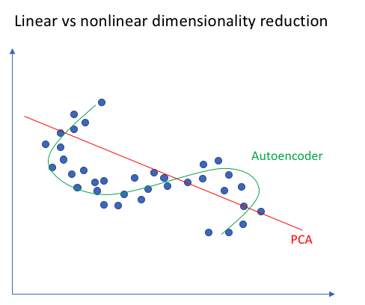
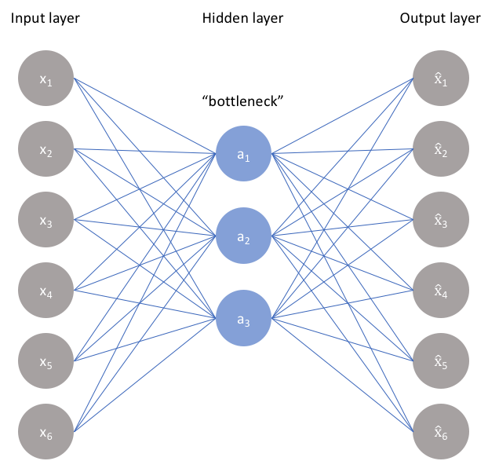
Auto-encoder
Non-linear PCA !
Learning non-linear manifolds

Slide 25
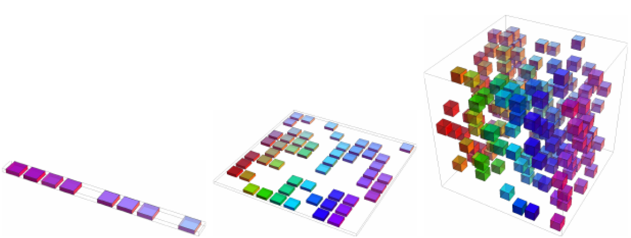
Curse of Dimensionality
More number of features or dimensions, better is the classification accuracy
However, at higher dimension, data distribution become sparser; as number of observation or data points is limited
In case of sparsely distributed space, generalization error likely to be more…..

Slide 26
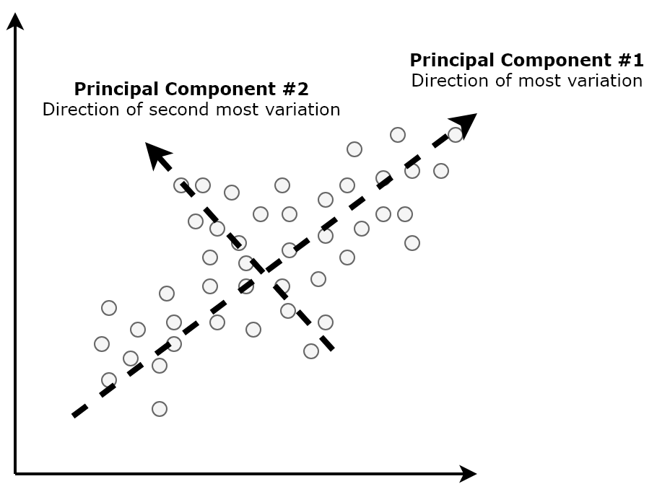
Principle Component Analysis
Finding the transformation such that first component axis is orienting in direction of maximum data variance; second axis in perpendicular to the first component axis, and in direction of maximum data variance…and so on…

Slide 27
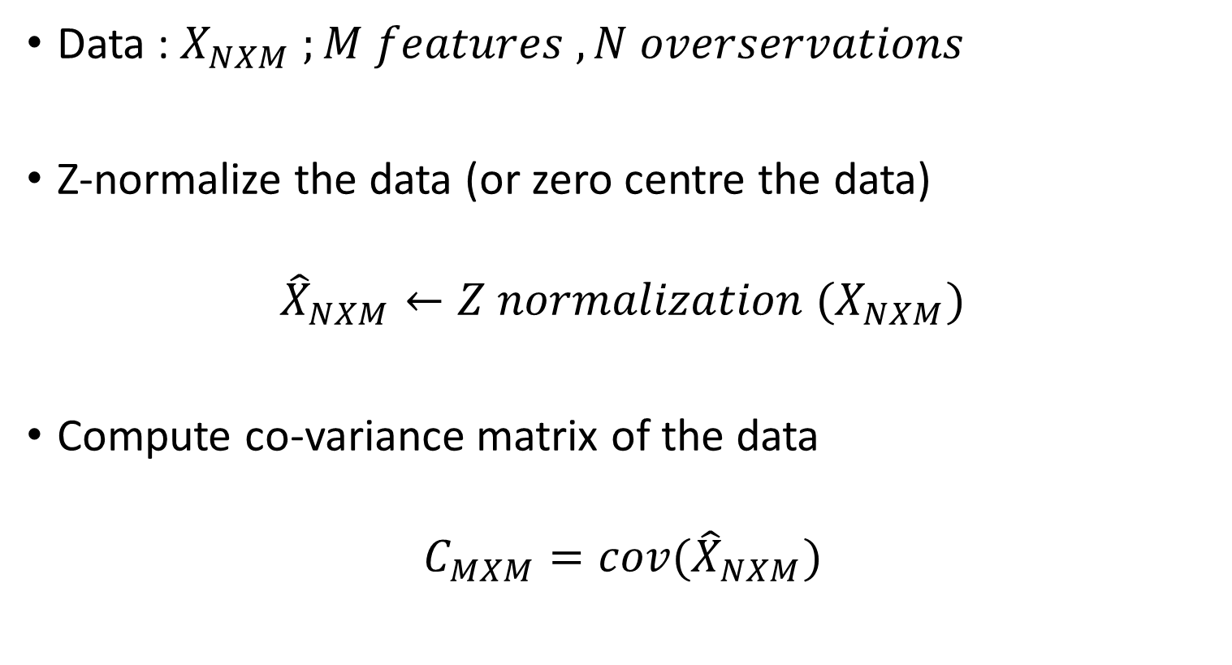
Principle Component Analysis
Data : $X_{NXM} ;M features , N overservations$
Z-normalize the data (or zero centre the data)
$${\hat{X}}_{NXM}←Z normalization (X_{NXM})$$
Compute co-variance matrix of the data
$$C_{MXM}=cov({\hat{X}}_{NXM})$$

Slide 28

Principle Component Analysis
Compute Eigen vector and Eigen value of co-variance matrix
$$C_{MXM}V_{MXM}= V_{MXM}{Diag(λ}_{M})$$
Sort (re-arrange) the Eigen vectors as per descending order of their Eigen values (e.g. variance)
Select first m number of components; generally m<<M, apply transformation
$$C_{MXM}{\hat{V}}_{MXM}={\hat{V}}_{MXM}{Diag(\hat{λ}}_{M})$$
$${{PC}_{NXm}=\hat{X}}_{NXM}∙{\hat{V}}_{MXM}(:,1:\text{m})$$

Slide 29
Principle Component analysis
Selection of number components are either based on total variance they retain or arbiter
After applying PCA transformation, resulting data in each dimension are de-correlated.
Do we need do data normalization again, to used it for DL…?

Slide 30
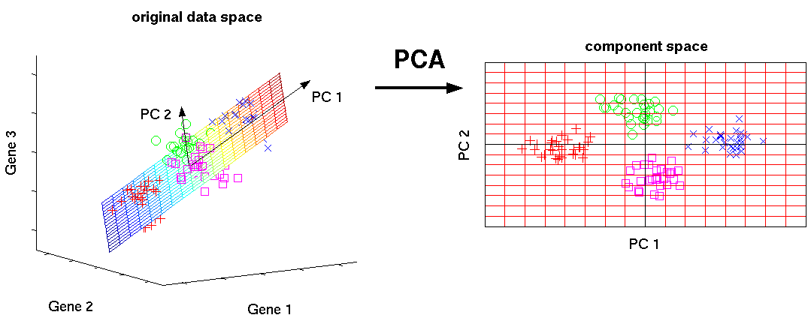
PCA for dimension reduction and data visualization
https://www.analyticsvidhya.com/wp-content/uploads/2016/03/1-1.png

Slide 31

ECG signal
amp
$X$ : samples X channels
time

Slide 32
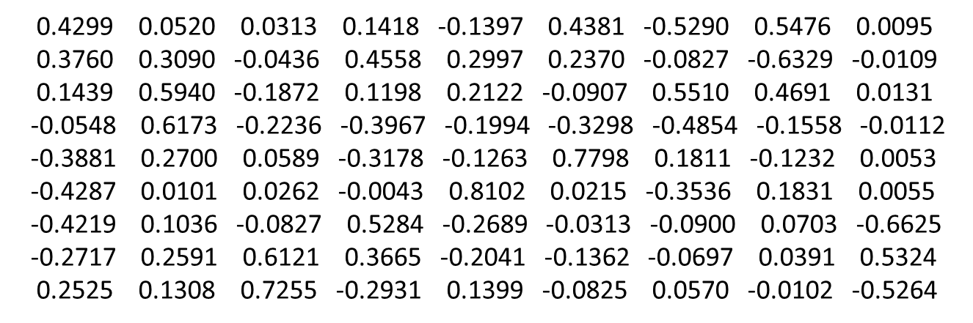
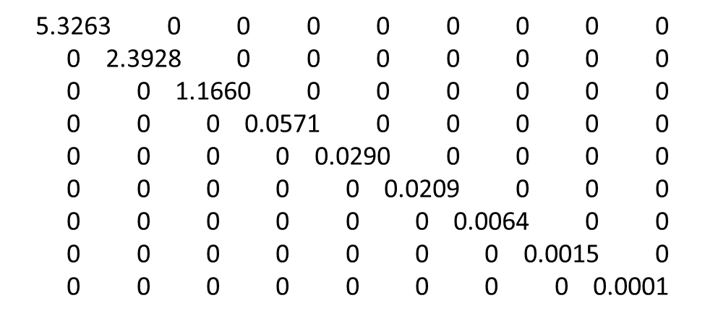


Eigen decomposition
$$V=$$
Explained variance(%)
$$λ=$$

Slide 33
PCs
$$PCs=XV$$

Slide 34
Retained 1 PC / Dim
$$\dim{=1}$$
$$Reproj_{X}=PCs\left(:,1:dim\right)∗V^{T}(1:dim,:)$$

Slide 35
Retained 2 PC / Dim
$$\dim{=2}$$
$$Reproj_{X}=PCs\left(:,1:dim\right)∗V^{T}(1:dim,:)$$

Slide 36
Retained 3 PC / Dim
$$\dim{=3}$$
$$Reproj_{X}=PCs\left(:,1:dim\right)∗V^{T}(1:dim,:)$$

